Slide 1

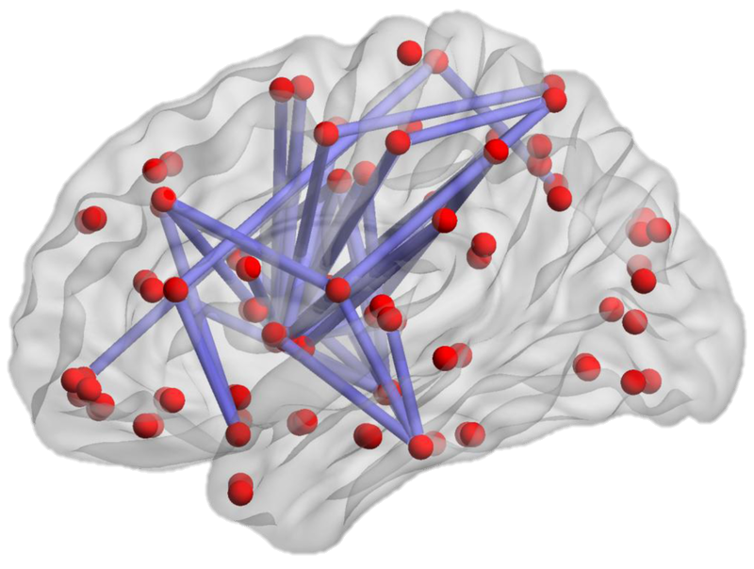
Paperless•AI
Card recommendation engine written in python using deep neural network.
Stampy Day 2016
Si Te Feng

Slide 2
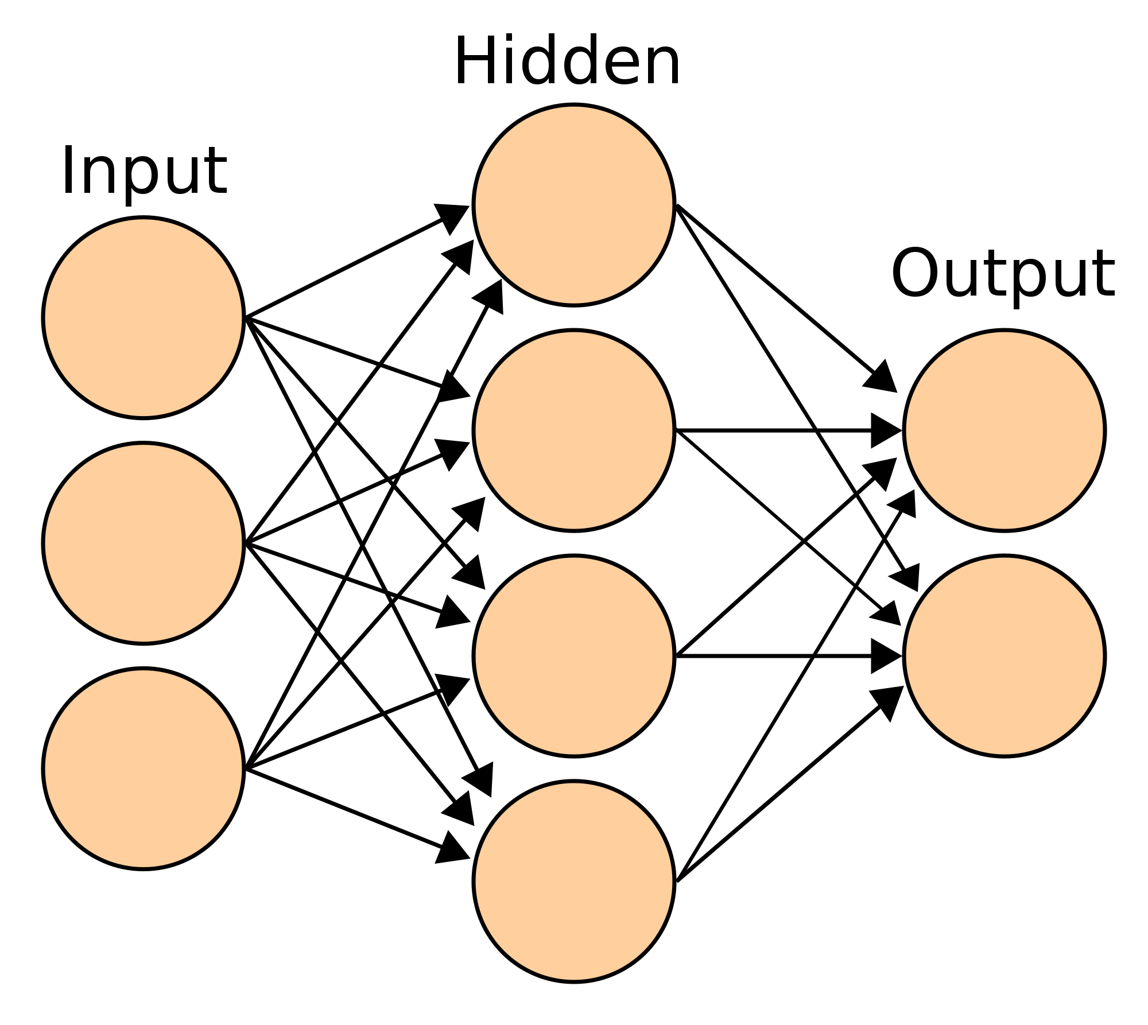
Artificial neural networks

Slide 3
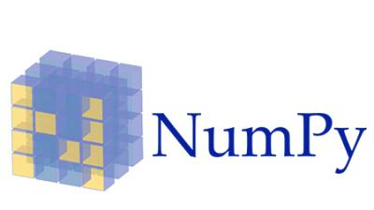
Frameworks
TensorFlow: Open source machine intelligence framework. Provides state of the art neural network training algorithms
Numpy: Computation framework in Python. Useful for matrix transformations on input data

Slide 4
Paperless•AI Usage
Given a database of users sending data with Cards [A, B, C, D]
Database => { ABC BC BCD ACD AC }
And given a user who has sent these cards in the past:
CurrentUserCards => [B, C]
PaperlessAI predicts the next card the user is going to send, sorted by chance:
CurrentPrediction => [A: 25.1%, D: 7.16%]

Slide 5

How to train your Paperless•AI

Slide 6
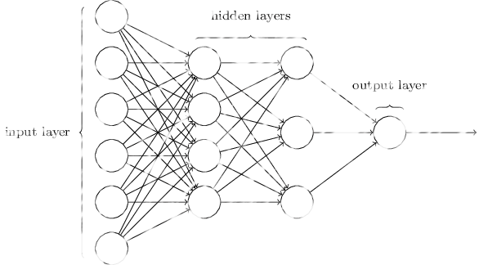
Training example (Backpropagation method)
Given User Card Data: [A, B, C]
Input: Card Tags
Positive Correlation | Negative Correlation
Input UserCardHistory => [B, C] CurrentCard => A Output SendPossibility => 1.0 | Input UserCardHistory => [B, C] CurrentCard => D Output SendPossibility => 0
Input UserCardHistory => [A, C] CurrentCard => B Output SendPossibility => 1.0 | Input UserCardHistory => [A, C] CurrentCard => E Output SendPossibility => 0
Current Card Tags
1
Previous Card Tags

Slide 7
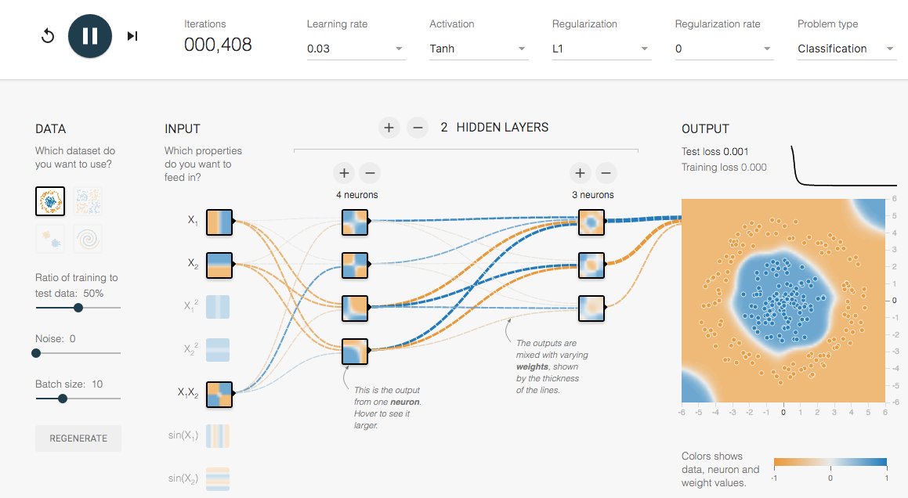
Trained Paperless•AI
Example: Neural Net Visualization
Example: Error rate vs. Training Time

Slide 8
Using Paperless•AI - example
Input: Card Tags Tensor
0
0
?
?
Current Card Tags
1
?
3.10% chance user will send another orange card next
?
%
2
?
0.031
9
?
?
Previous Card Tags Sum
3
3 means user has previously sent 3 cards with orange color

Slide 9
What does this mean for our users?
Personalized recommendation engine that can help our users to pick their next card in 1 click.
More exposures on our best designs leads to a higher perceived brand value
Retain new customers

Slide 10
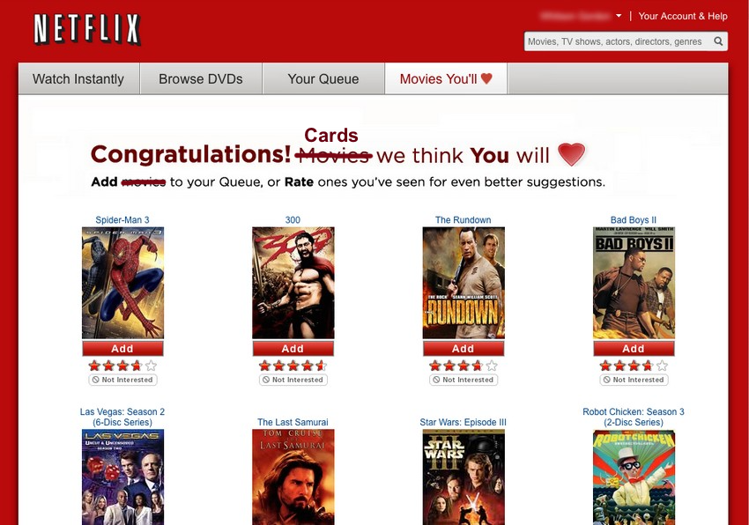
product Rendering

Slide 11
Paperless•AI

